Slide 1
First Dual Cross Country

Slide 2
Lessons leading up to XC
Stage I, Lesson 4
Safety of flight, Airports, Aeronautical charts, Airspace
Stage I Lesson 5
RADAR and ATC, Radio Procedures, Sources of Flight Info
Stage II, Lesson 9
Weather Forecasting Process, Printed Reports and Forecasts, Graphic Weather Products, Sources of Weather Info
Stage III, Lesson 11
Predicting Performance, Weight and Balance, Flight Computers
Stage III, Lesson 12
Pilotage and Dead Reckoning, VOR Navigation, ADF Navigation, Advanced Navigation (VORDME/GPS/INS)
NOW we plan a dual cross country flight!

Slide 3
Review – Questions?
The Forecasting Process
Forecasting methods
Types of forecasts
Compiling and processing weather data
Forecasting accuracy and limitations
Notes:
Jeppesen Syllabus – Stage II Ground Lesson 09

Slide 4
Review – Questions?
Printed Reports and Forecasts
Aviation Routine Weather Report (METAR)
Radar Weather Reports
Pilot Weather Reports
Terminal Aerodrome Forecasts (TAF)
Aviation Area Forecast (FA)
Winds and Temperature Aloft Forecasts
Severe Weather Reports and Forecasts
AIRMET/SIGMET/Convective SIGMET
Notes:
Jeppesen Syllabus – Stage II Ground Lesson 09

Slide 5
Review – Questions?
Graphic Weather Products
Surface analysis chart
Weather Depiction Chart
Radar Summary Chart
Satellite Weather Pictures
Low-level Significant Weather Prog Charts
Convective Outlook Chart
Forecast Winds and Temperatures Aloft Chart
Volcanic Ash Forecast and Dispersion Chart
Notes:
Jeppesen Syllabus – Stage II Ground Lesson 09

Slide 6
Review – Questions?
Source of Weather Information
Pre-flight weather sources
In-flight weather sources
Enroute Flight Advisory Service
Weather Radar Services
Automated Weather Reporting Systems
Notes:
Jeppesen Syllabus – Stage II Ground Lesson 09
Notes:
EFAS Update: https://en.wikipedia.org/wiki/Flight_watch
EFAS now 122.2 – no more 122.0
Also FIS-B via ADS-B IN

Slide 7
Review…questions?
Predicting Performance
Aircraft Performance and Design
Chart Presentations (Sectional, TAC etc.)
Factors affecting performance
Takeoff and Landing performance
Climb Performance
Cruise Performance
Using Performance Charts
Notes:
Jeppesen Syllabus – Stage III Ground Lesson 11

Slide 8
Review…questions?
Weight and Balance
Importance of Weight
Importance of Balance
Terminology
Principles of Weight and Balance
Computation Method
Table Method
Graph Method
Weight shift formula
Effects of operating at High Total Weights
Flight at various CG positions
Notes:
Jeppesen Syllabus – Stage III Ground Lesson 11

Slide 9
Review…questions?
Flight Computers
Mechanical Flight Computers
Time, speed and distance
Airspeed and Density Altitude Computations
Wind Problems
Conversions
Solving multi-part problems
Notes:
Jeppesen Syllabus – Stage III Ground Lesson 11

Slide 10
Review…questions?
Pilotage and Dead Reckoning
Pilotage,
Dead Reckoning
Flight Planning
VFR Cruising Altitudes
Flight Plan
Lost Procedures
Notes:
Jeppesen Syllabus – Stage III Ground Lesson 12

Slide 11
Review…questions?
VOR Navigation
Ground and Airborne equipment
VOR Orientation and Navigation
VOR Checkpoints and Test signals
VOR Precautions
HIS
DME
Notes:
Jeppesen Syllabus – Stage III Ground Lesson 12

Slide 12
Review…questions?
ADF Navigation
ADF Equipment
Orientation
Homing
ADF Intercepts and Tracking
Movable Card Indicator
RMI (Radio Magnetic Indicator)
ADF Limitations
Notes:
Jeppesen Syllabus – Stage III Ground Lesson 12

Slide 13
Review…questions?
Advanced Navigation
VOR/DME based navigation
INS
GPS
Notes:
Jeppesen Syllabus – Stage III Ground Lesson 12

Slide 14
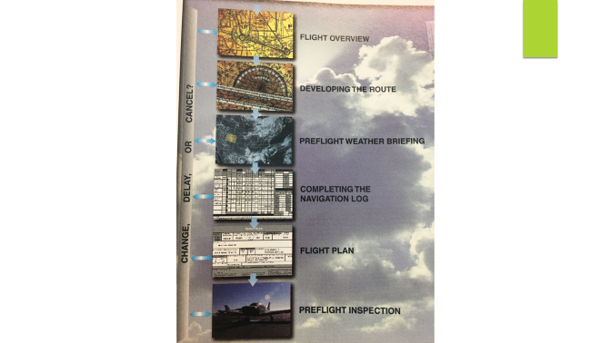
Cross Country Planning
The flight planning process
Flight Overview
Developing a route
Preflight weather briefing
Completing a Navigation Log
Flight Plan – creating and filing
Preflight inspection
Notes:
Stage III, Lesson 14

Slide 15
Cross Country Planning
The Flight
Departure – KCRQ
Destination – KCNO (Chino)
Diversion airport
Return to KCRQ
Two souls; Student and CFI both in front seat (JD is 145 lbs.)
Full fuel
Notes:
Stage III, Lesson 14

Slide 16
Cross Country Planning
The Regs – what do we need?
Called out in CFR 14, Part 91, 91.103 (preflight action)
Weather reports and forecasts (WX-Brief/DUATS)
Fuel requirements for the flight
Alternatives if the flight cannot be completed (diversion)
Runway lengths at airport of intended use (ANY flight - Chart Supplement, Sectional)
Takeoff and Landing performance data (POH/AFM)
Fuel requirements. VFR day requirements (91.151)
First airport, alternate then 30 minutes at normal cruise
Night – 45 mins

Slide 17
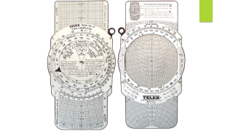
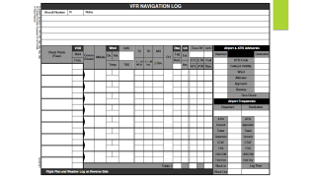
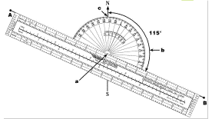
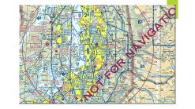

What do we need?
Sectional Chart
Chart Supplement
Flight Computer (E6B)
Plotter
Weight and Balance information for our airplane
Flight Performance for our airplane
A Navigation Log (Jeppesen in this case)
Notes:
Stage III, Lesson 14

Slide 18
Appendix

Slide 19
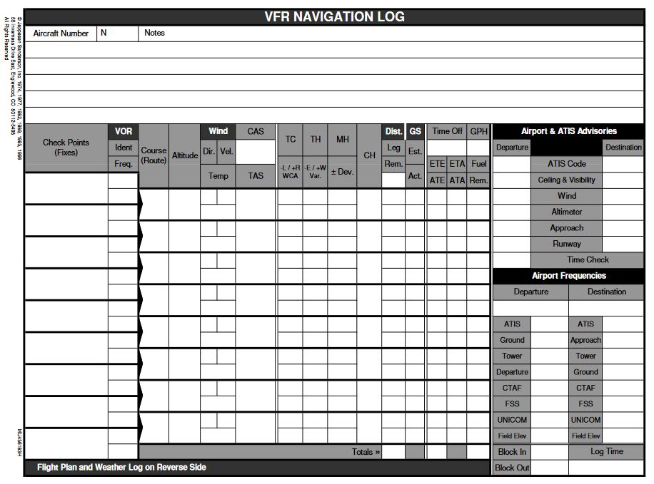

Slide 20
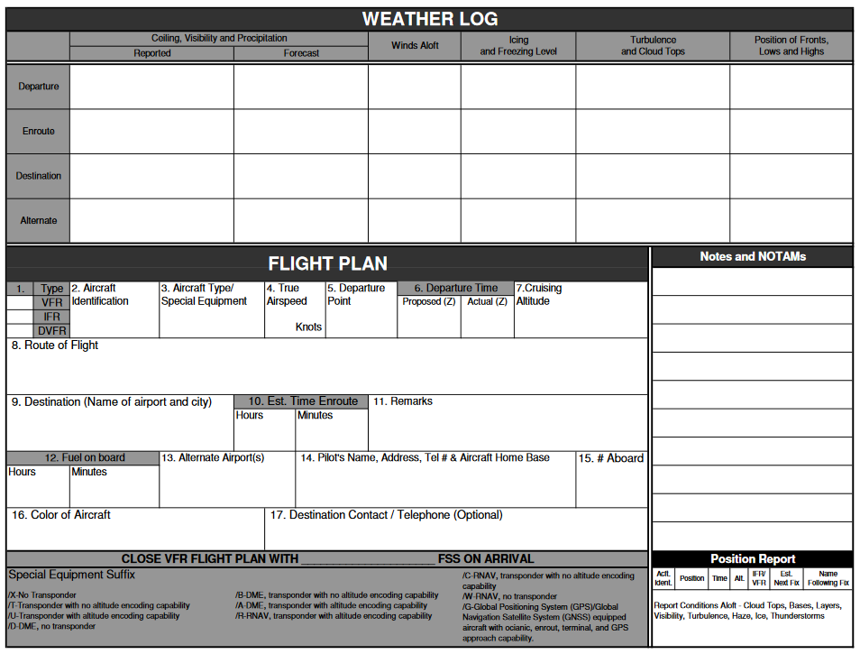

Slide 21
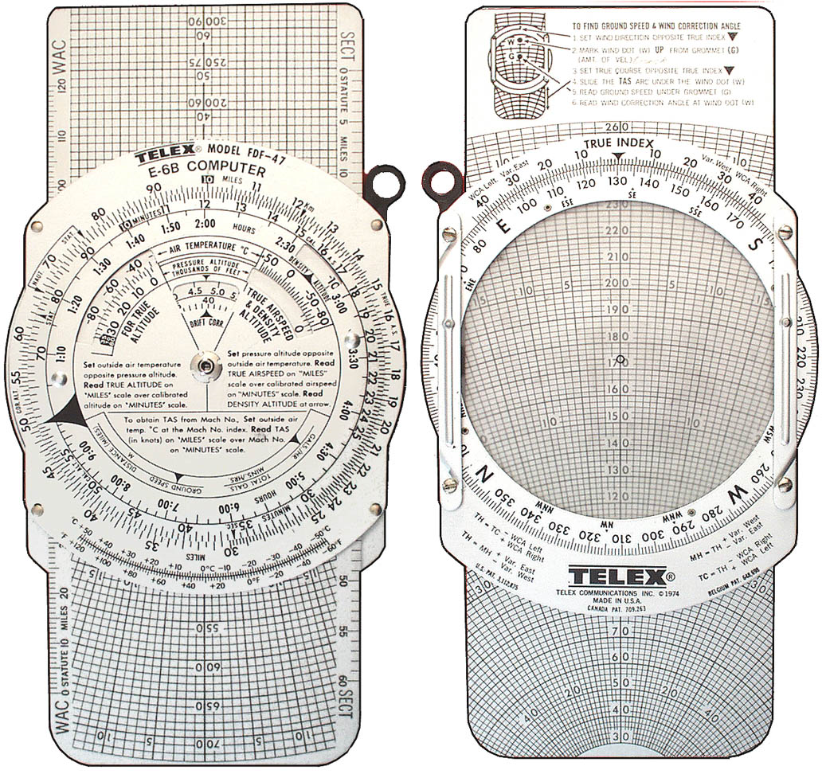

Slide 22
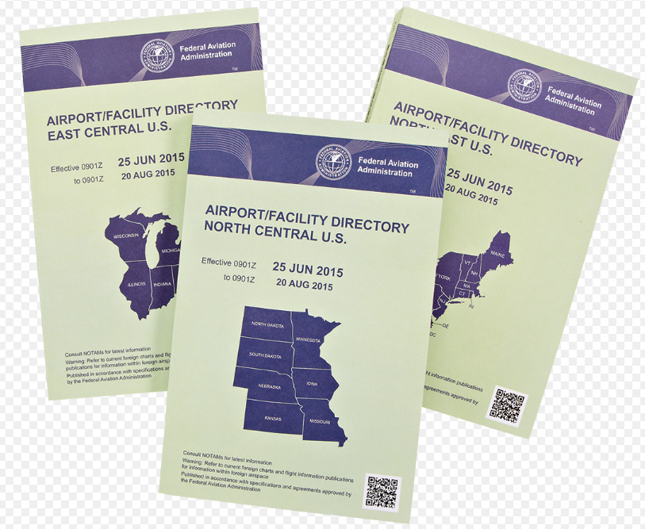

Slide 23
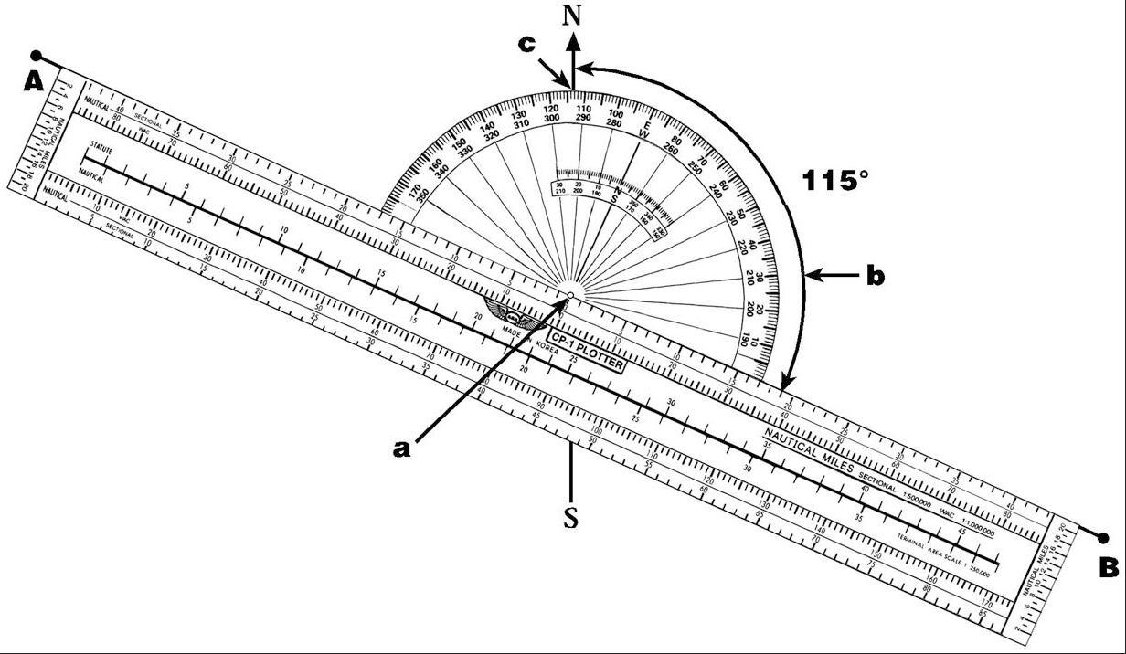

Slide 24
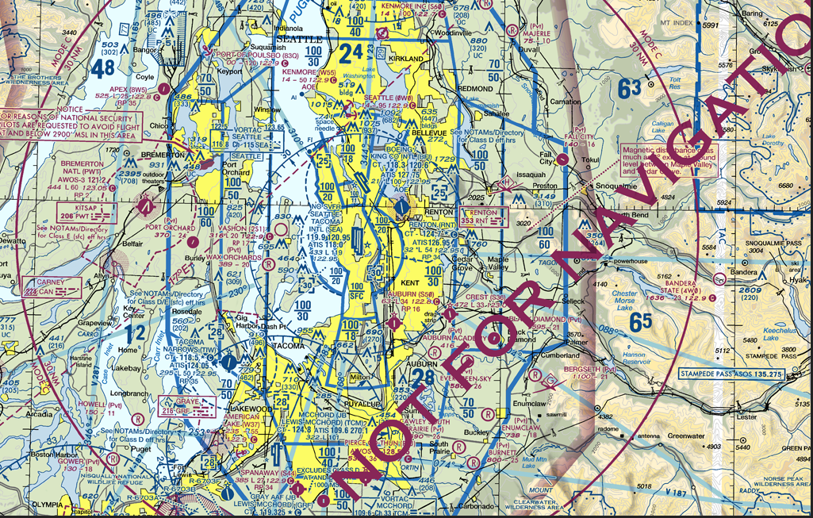

Slide 25
